Slide 1


Role of Local Authorities in U-space Implementation:
What does it mean in practice?
European Parliament
Alterio Spinelli 3H1
23 Jan 2024,
Brussels
Dr Vassilis AGOURIDAS
UIC2 Leader (EU’s CIVITAS Initiative)
Head of EU Public Co-Creation & Ecosystem Outreach (AIRBUS Urban Mobility)

Slide 2
Urban Air Mobility (UAM)
A definition by UIC2
Urban? Suburban? Regional? Advanced? Innovative?....
‘Urban’ is simply used as a semantic to indicate…
Very-low altitude airborne traffic*, above populated areas, at scale, that is sustainably integrated with surface mobility systems
* Traffic manifested by various types of suitable airborne vehicles
UIC2 • Role of local authorities in U-space: what does it mean in practice? EU Parliament, Urban Intergroup, 23 Jan 2024, Brussels

Slide 3

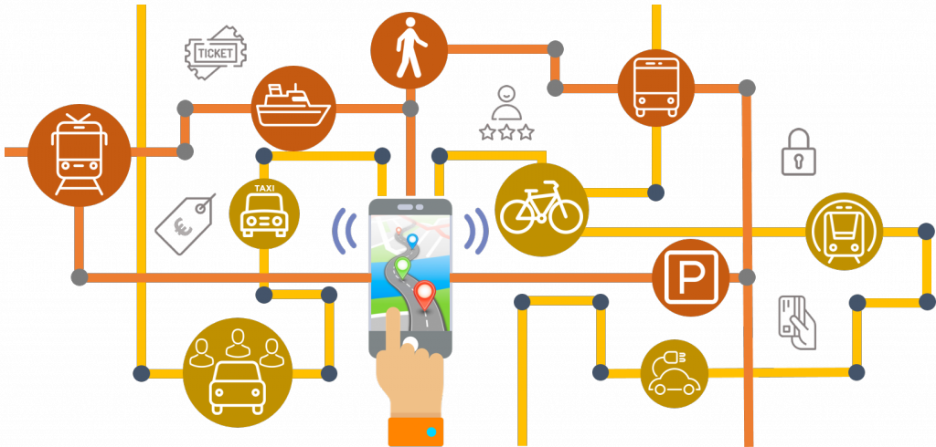
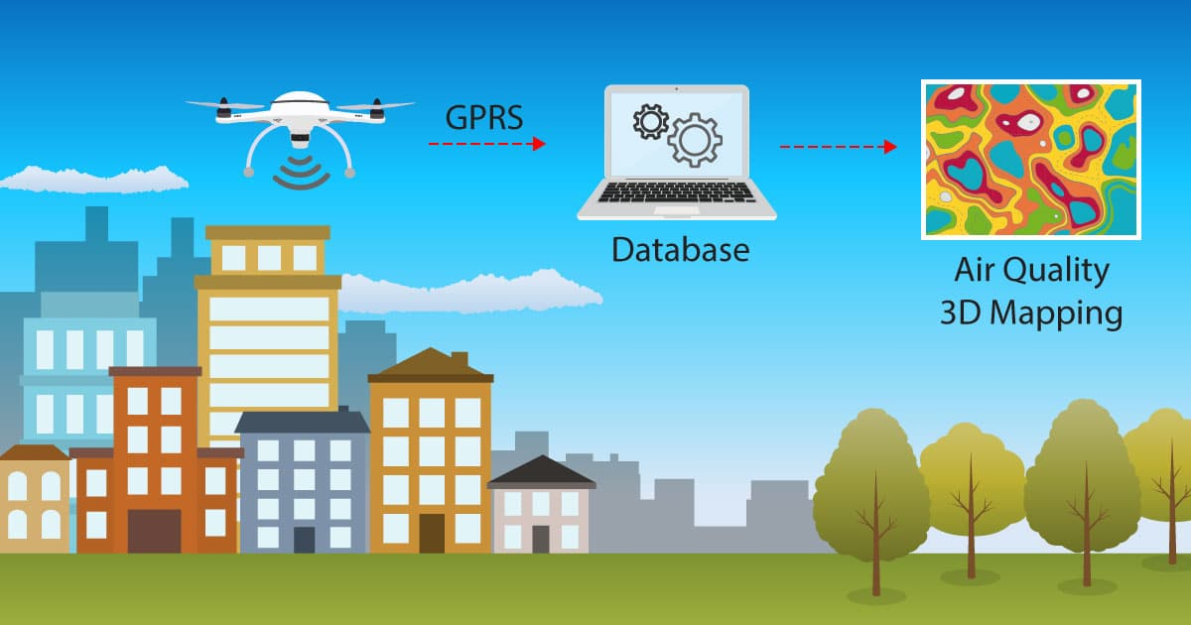
Urban Air Mobility (UAM)
Examples of emerging questions from the citizens and local authorities viewpoints
… in which way can urban aviation help mobility systems and city operations?
Source: NASA, 2022
… how safe is it to fly at low altitudes above people?
This Photo by Unknown Author is licensed under CC BY
Source: https://ipsoft.co.za/, 2019
3
UIC2 • Role of local authorities in U-space: what does it mean in practice? EU Parliament, Urban Intergroup, 23 Jan 2024, Brussels

Slide 4
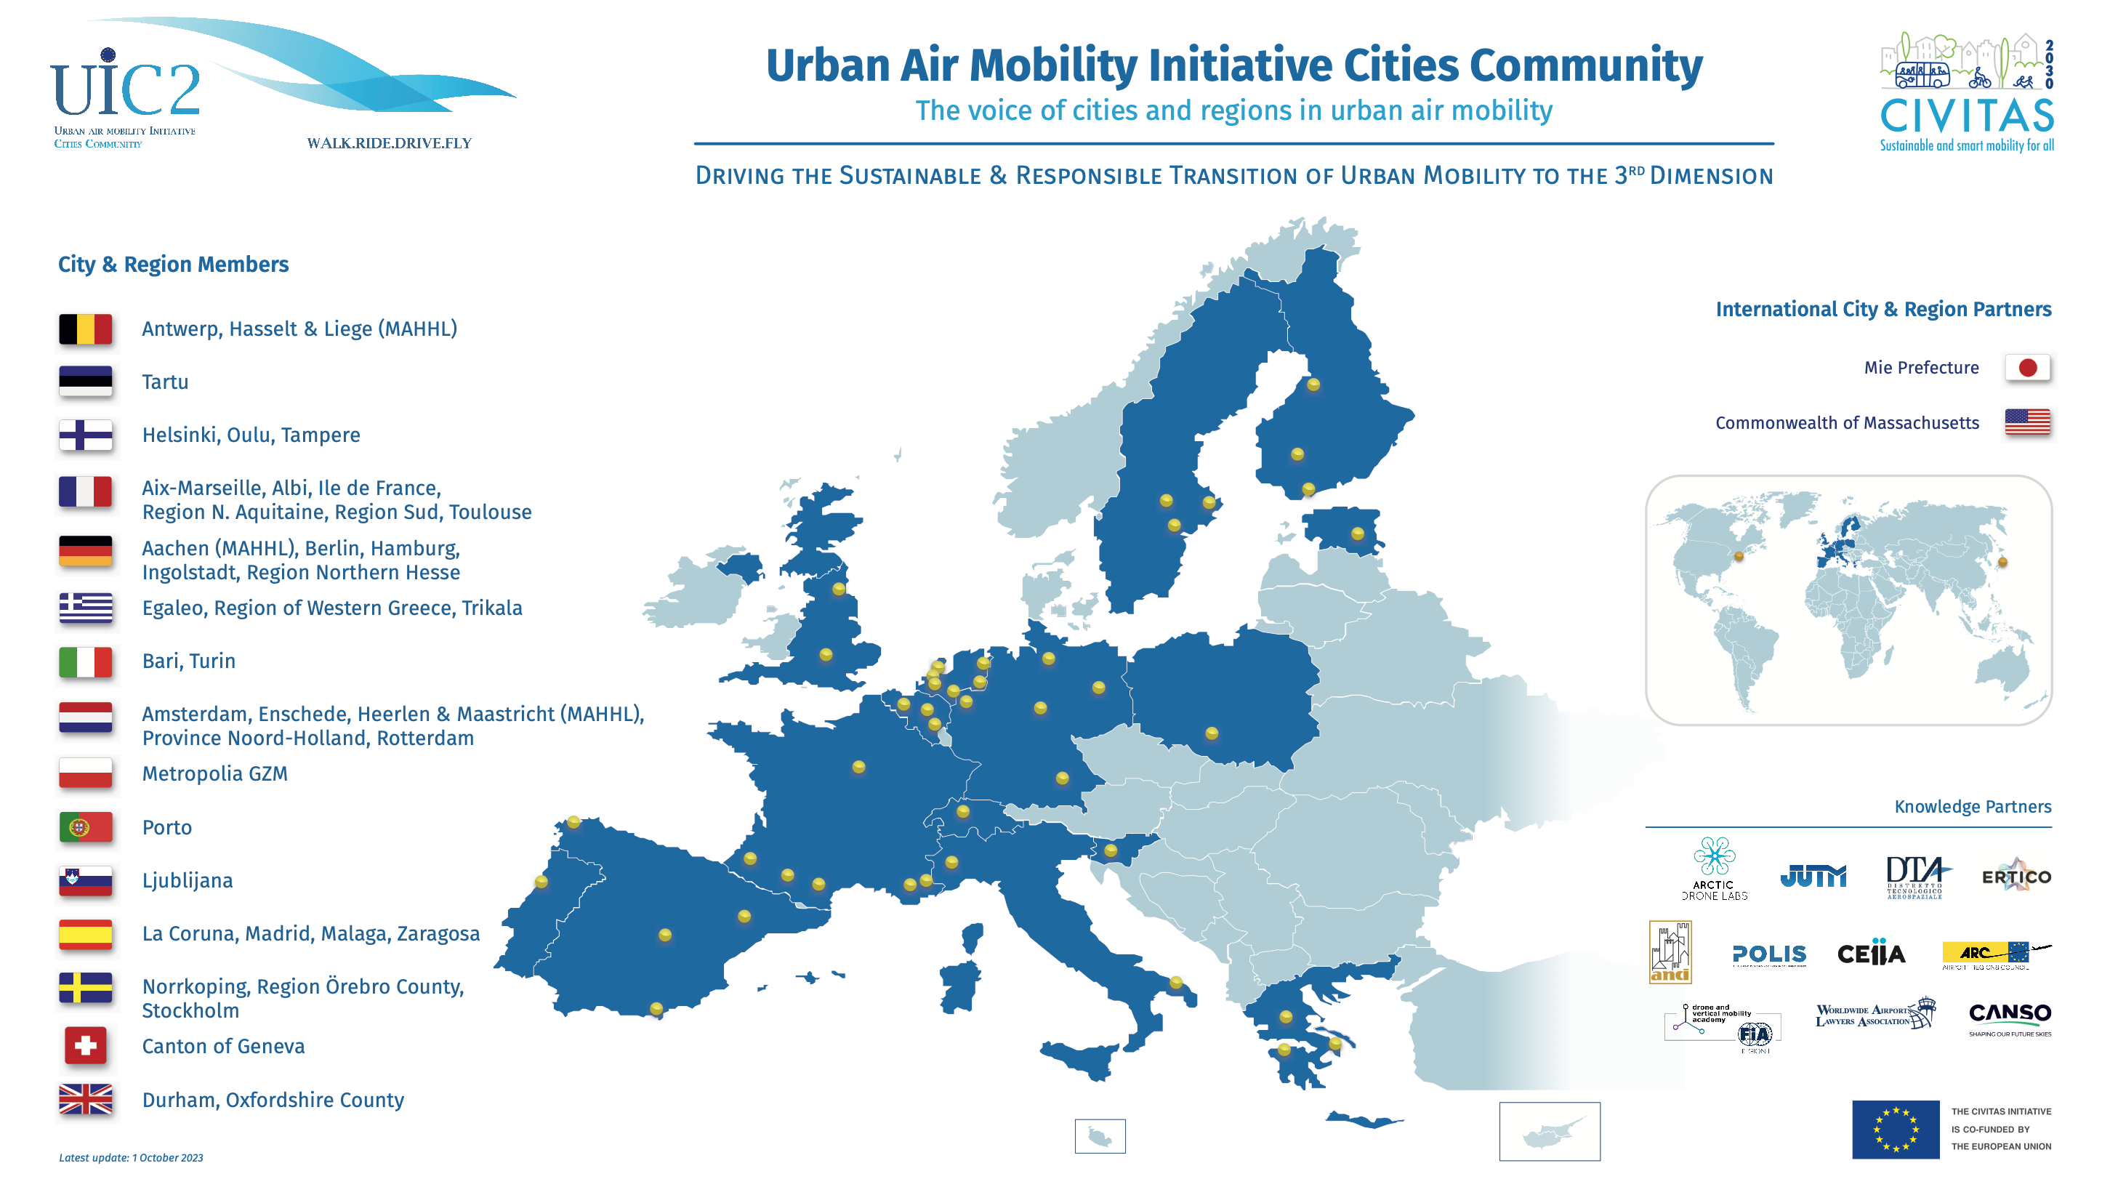

Slide 5
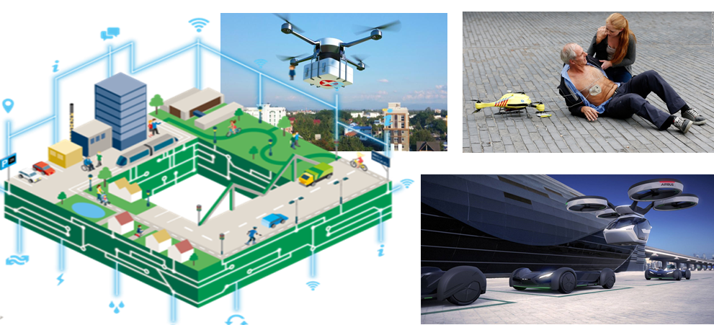
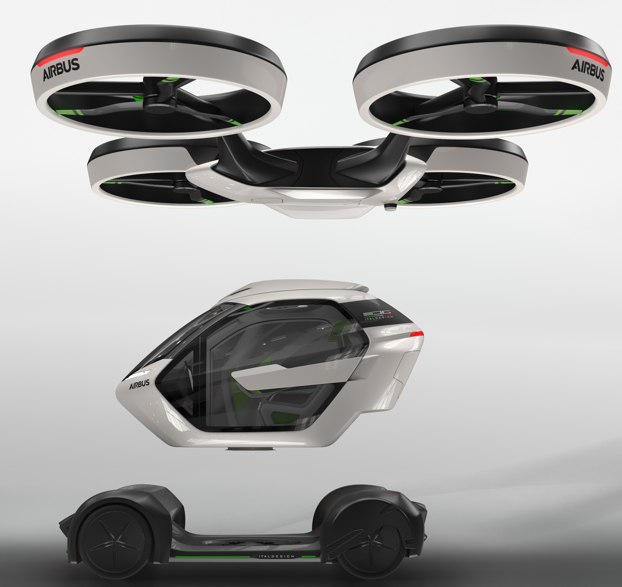
Scope of the UIC2 activities
Source: TU Delft
City-centric &
Citizen needs-driven
Source: Dronebelow.com
Sustainable Urban Mobility
Policy & Demonstrators
focused on UAM by addressing:
UAM interfaces with public transport*
Mobility as a Service
Ground infrastructure for UAM
ATM / UTM concepts for UAM in accordance with the U-Space framework
Source: SDU Odense University
* Or other interfaces: e.g. logistics platform, emergency services hubs, etc.
UIC2 • Role of local authorities in U-space: what does it mean in practice? EU Parliament, Urban Intergroup, 23 Jan 2024, Brussels

Slide 6
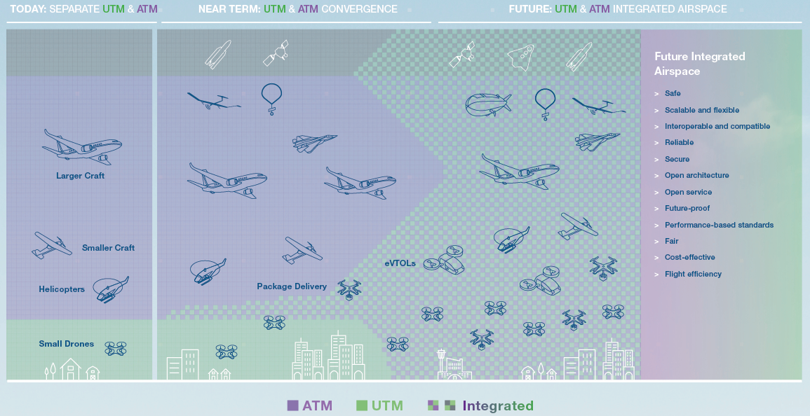
Towards Integrated Airspace
Digital transition to support integrated airspace
Emerging Governance Topics
- Role of local authorities, and
- Integrated mobility management
Source: Airbus Boeing Joint Paper: A New Era of Aviation, 2020
6
UIC2 • Role of local authorities in U-space: what does it mean in practice? EU Parliament, Urban Intergroup, 23 Jan 2024, Brussels

Slide 7

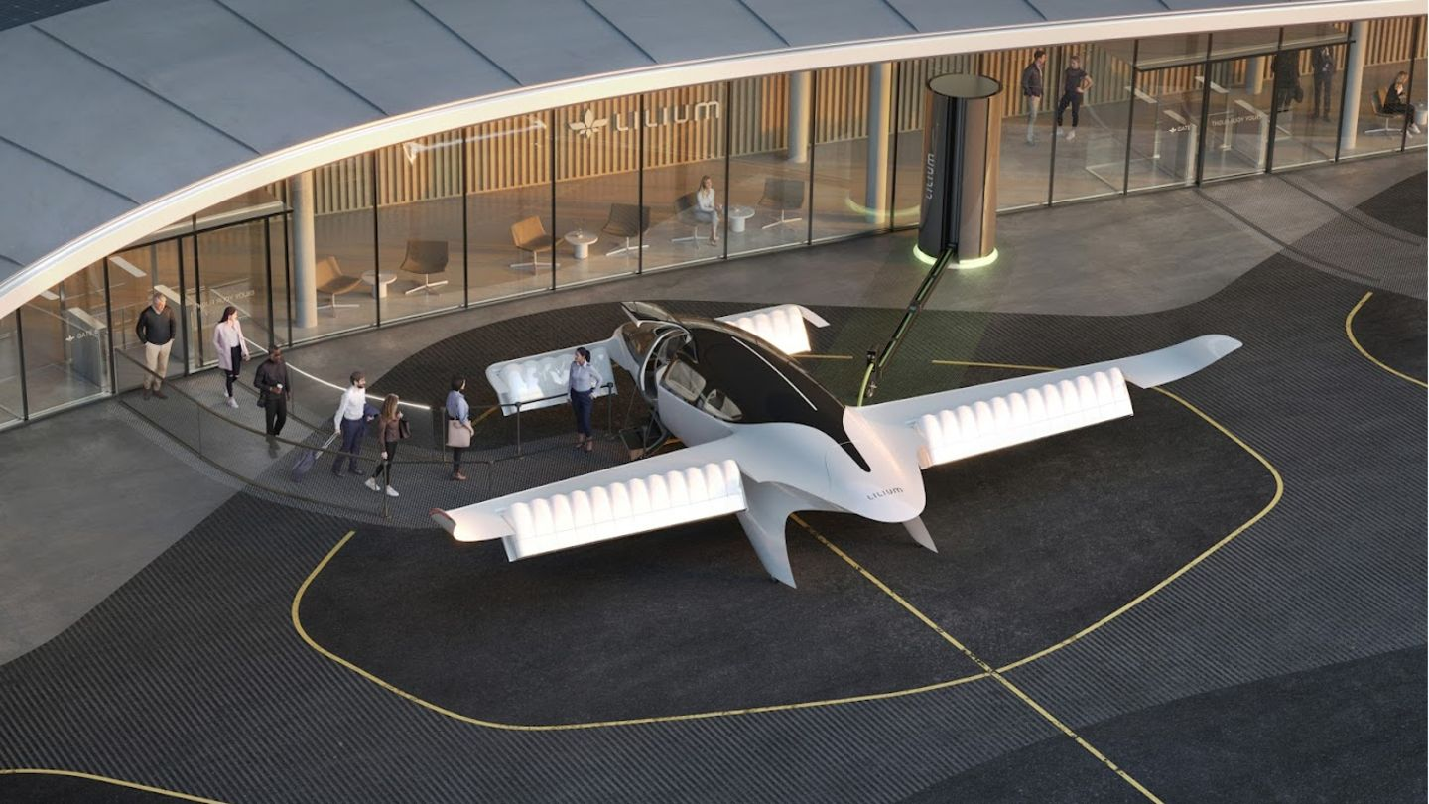

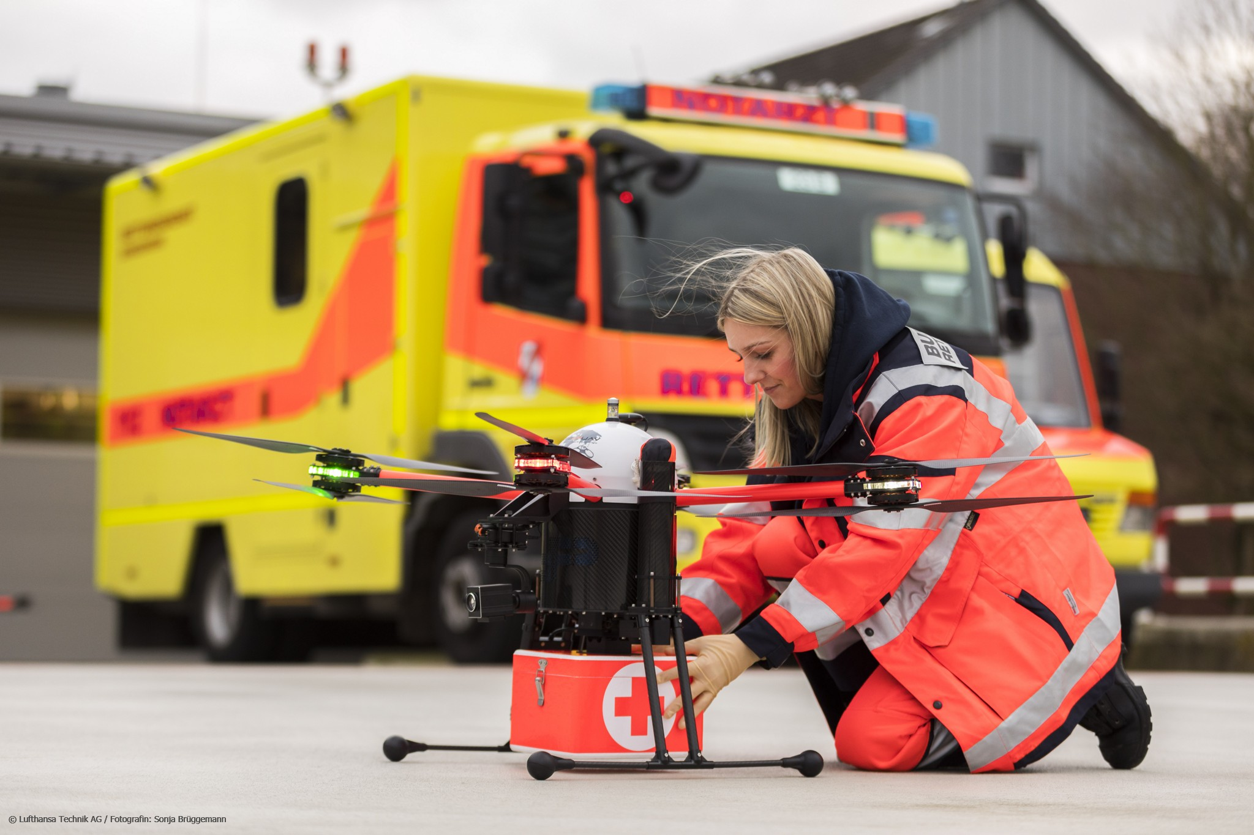
UAM offers cities & regions new opportunities . . .
But also new tasks and responsibilities for them
Source: Vertical Aerospace
Source: Lilium
At the same time, cities & regions, as a layer of government closest to citizens, are an essential player in having an influential / deciding role in the gove-rnance of the urban airspace / U-Space
Source: Volocopter
Source: Lufthansa Technik
7
UIC2 • Role of local authorities in U-space: what does it mean in practice? EU Parliament, Urban Intergroup, 23 Jan 2024, Brussels

Slide 8
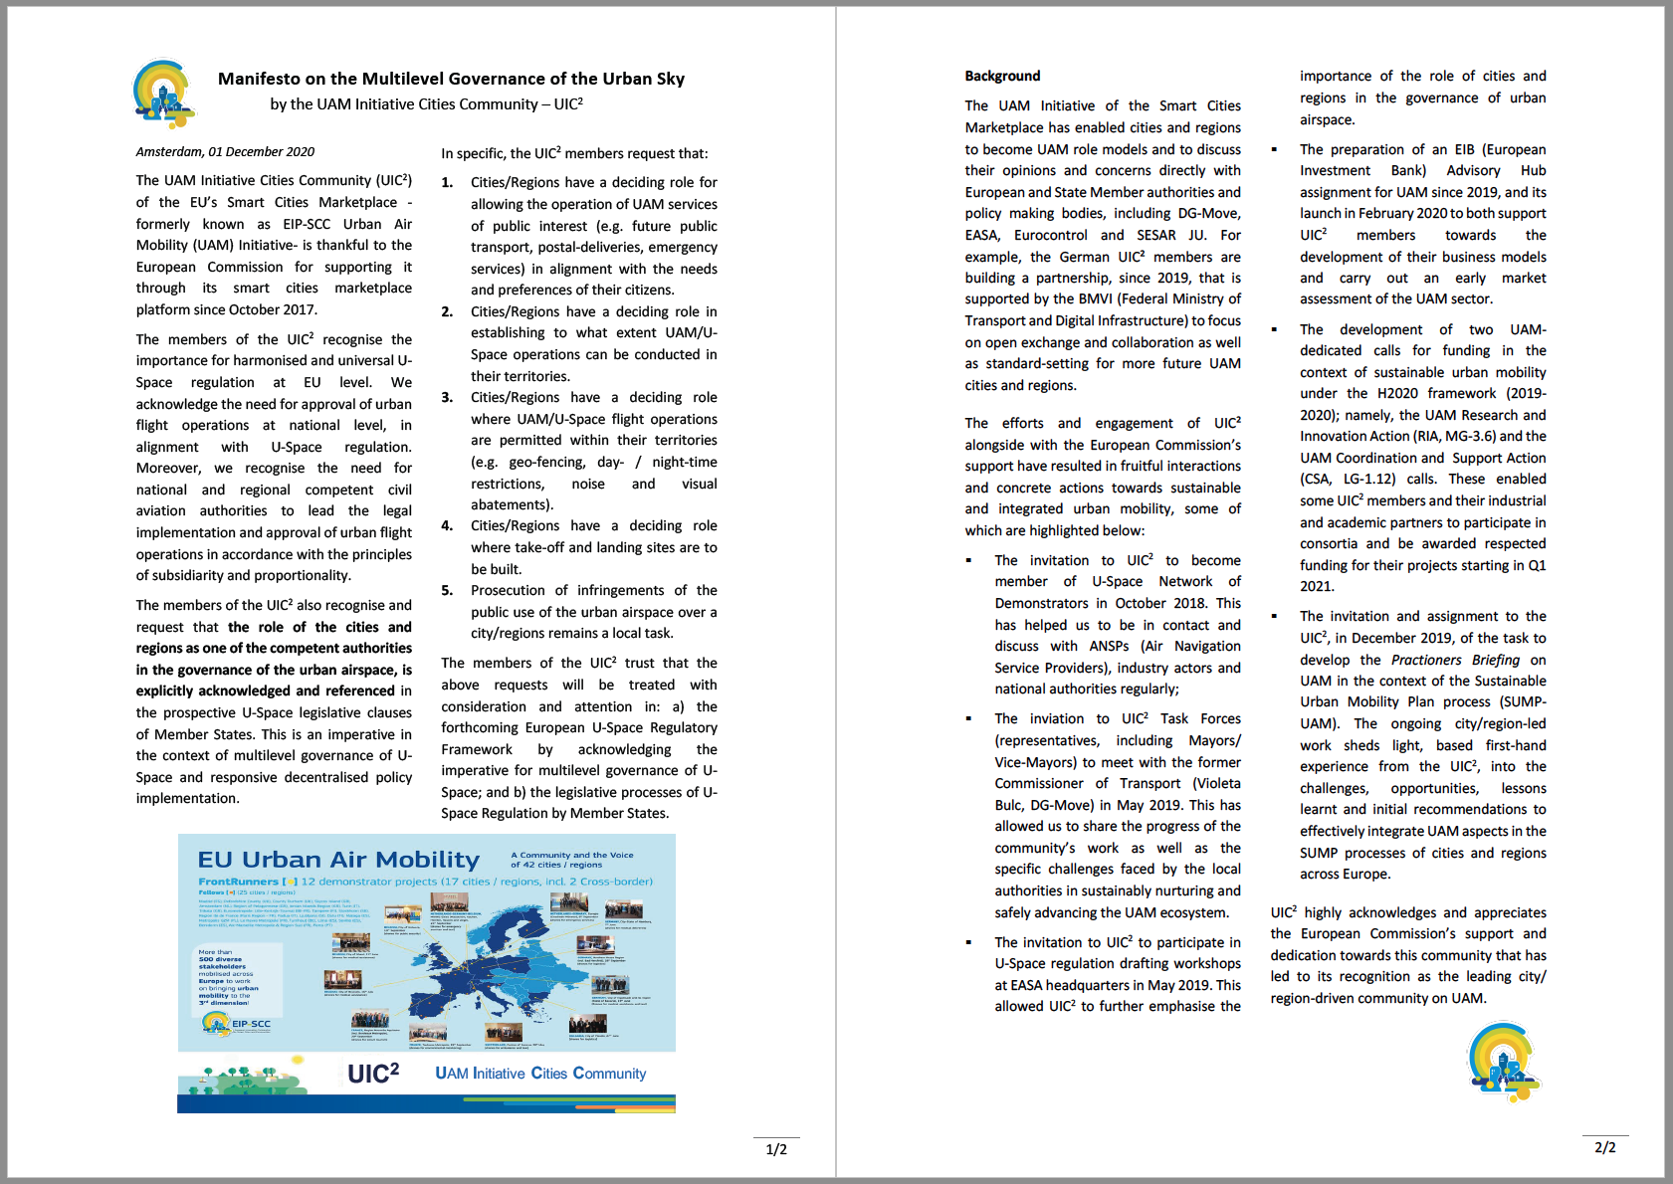









































UIC2 Manifesto on the
Multilevel Governance of the Urban Sky
European Cities and Regions already supporting …
… as of 15 Sep 2022
(Trikala)
(Bari)
(Plovdiv)
www.amsterdamdroneweek.com/manifesto
(Egaleo)
Organisations / Associations already supporting …
International (outside the EU) Cities and Regions already supporting …
8
UIC2 • Role of local authorities in U-space: what does it mean in practice? EU Parliament, Urban Intergroup, 23 Jan 2024, Brussels

Slide 9
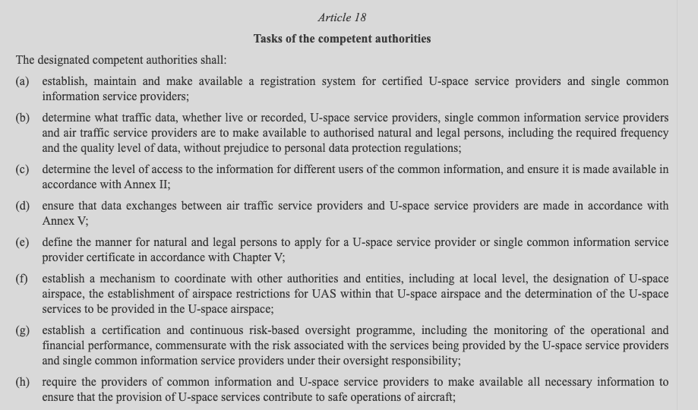
EU’s Regulatory Framework for U-Space:
Article 18(f)
Entry into force of the U-space regulatory framework by the EU’s Member States on 26th Jan 2023
A novel approach to build up the
coordination mechanism*
Extract from the Commission Implementing Regulation (EU) 2021/664 of 22 April 2021 on a regulatory framework for the U-space.
https://eur-lex.europa.eu/legal-content/EN/TXT/?uri=CELEX%3A32021R0664
Designated competent authorities
Other entities, incl. at local level
Coordination mechanism
Other authorities, incl. at local level
U-space airspace, restrictions, services
Authorities, entities, including at local level
U-space coordinator
Coordination mechanism
New tasks
New
processes
*based on Issue 1, AMCs/GM of (EU) 2021/664 published in Dec. 2022
9
UIC2 • Role of local authorities in U-space: what does it mean in practice? EU Parliament, Urban Intergroup, 23 Jan 2024, Brussels

Slide 10
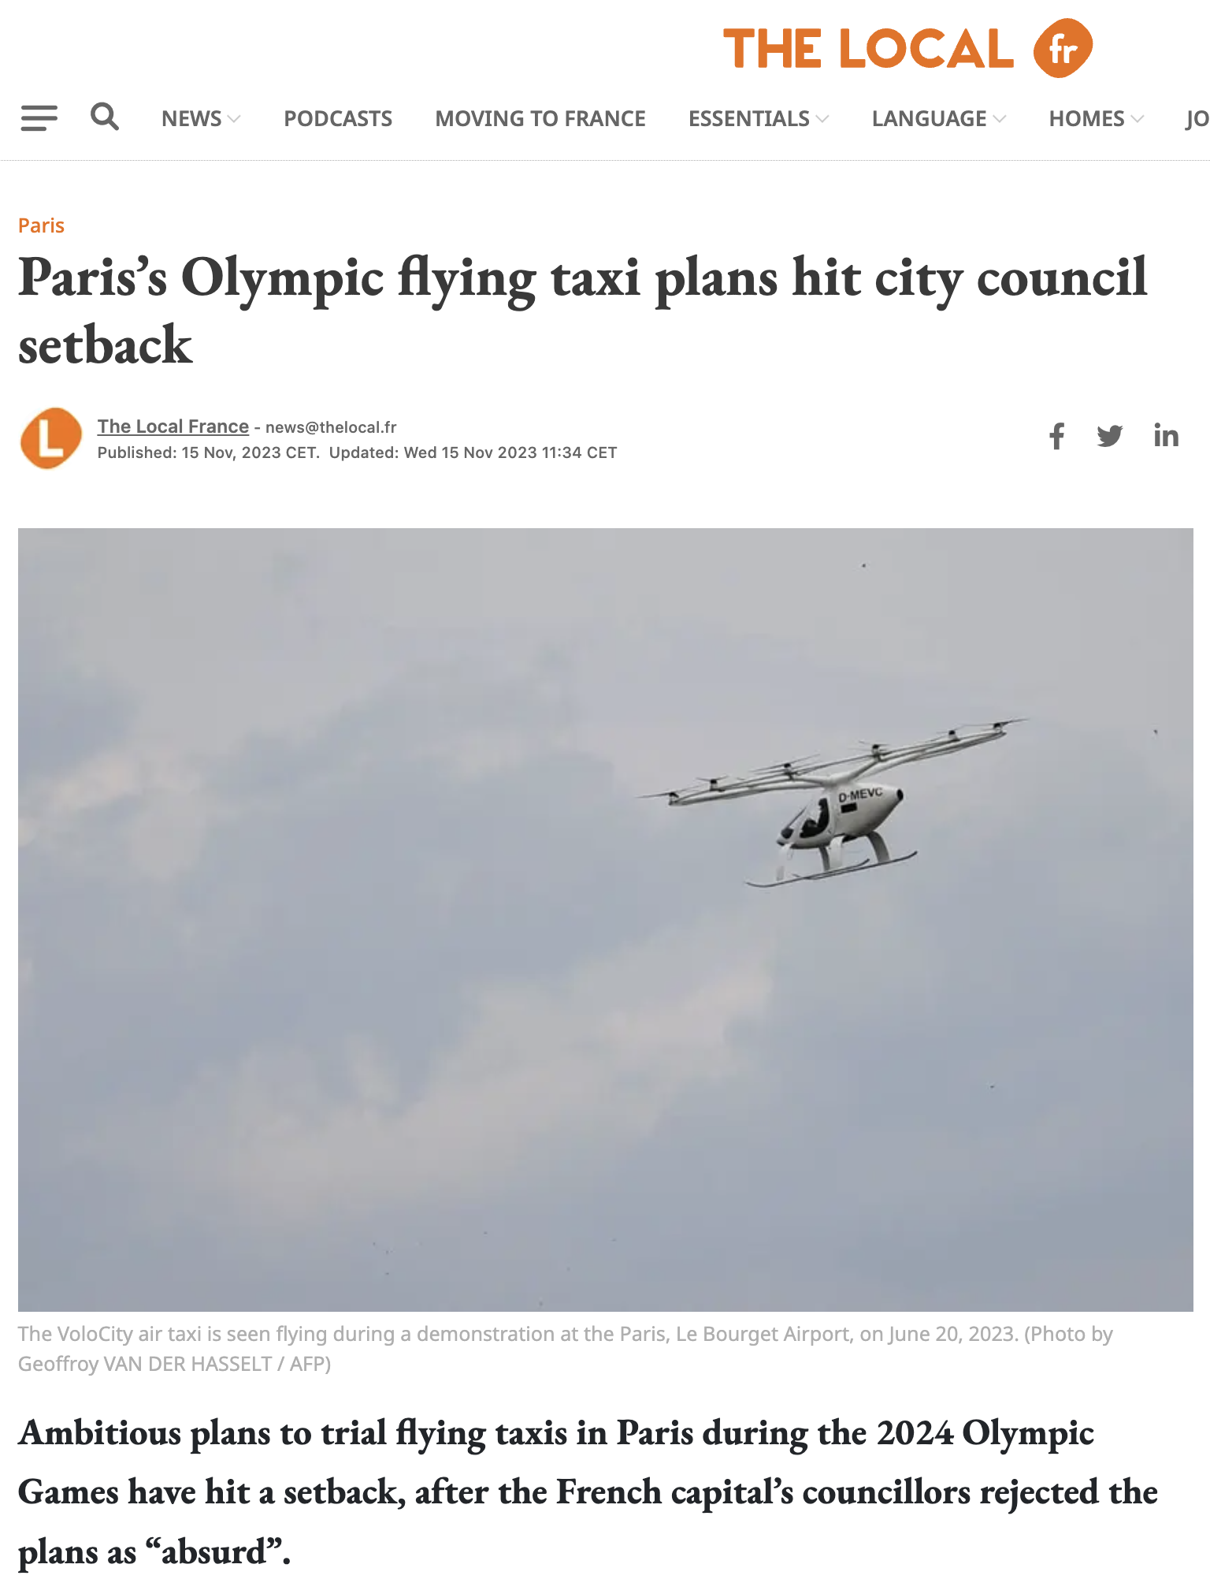
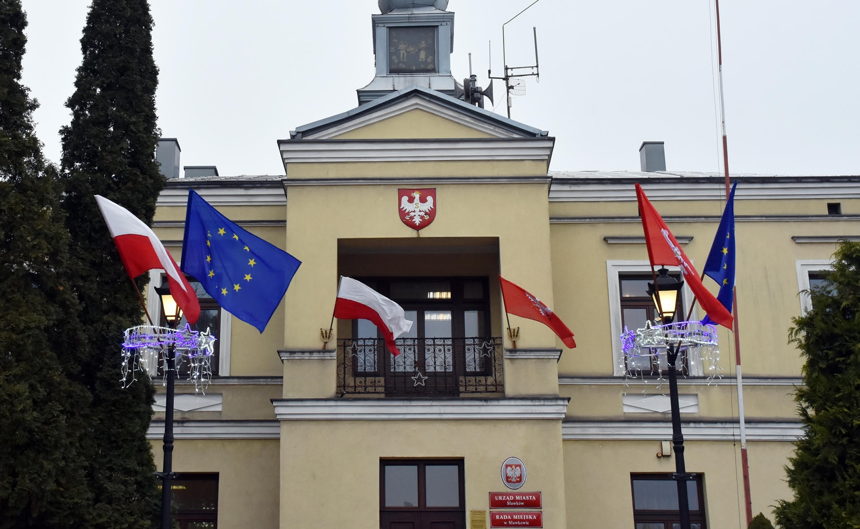
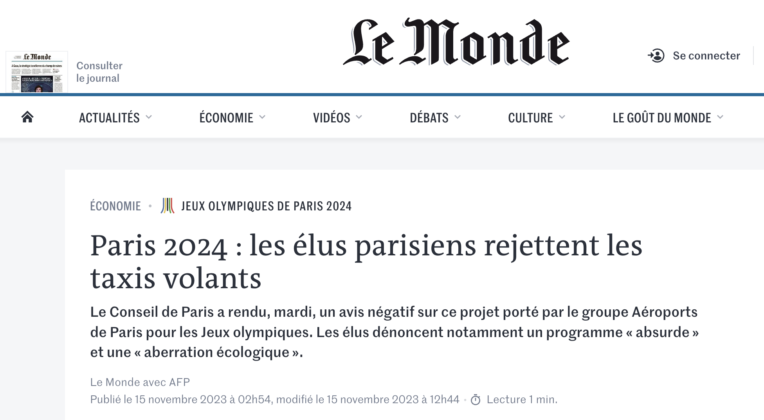
Reminder:
City Councils are part of the multi-level governance
Metropolia GZM and Sławków City Council in 2019
Concerns of city council:
Kindergarten in the area
Low level of understanding of the concept
Recent news,
Paris City Council, Nov. 2023
Source: https://www.lemonde.fr/economie/article/2023/11/15/paris-2024-les-elus-parisiens-rejettent-les-taxis-volants_6200105_3234.html
Source: https://www.thelocal.fr/20231115/pariss-olympic-flying-taxi-plans-hit-city-council-setback
10
UIC2 • Role of local authorities in U-space: what does it mean in practice? EU Parliament, Urban Intergroup, 23 Jan 2024, Brussels
Notes:
..w praktyce to w każdej dziedzinie można wspomóc się technologią BSP…

Slide 11
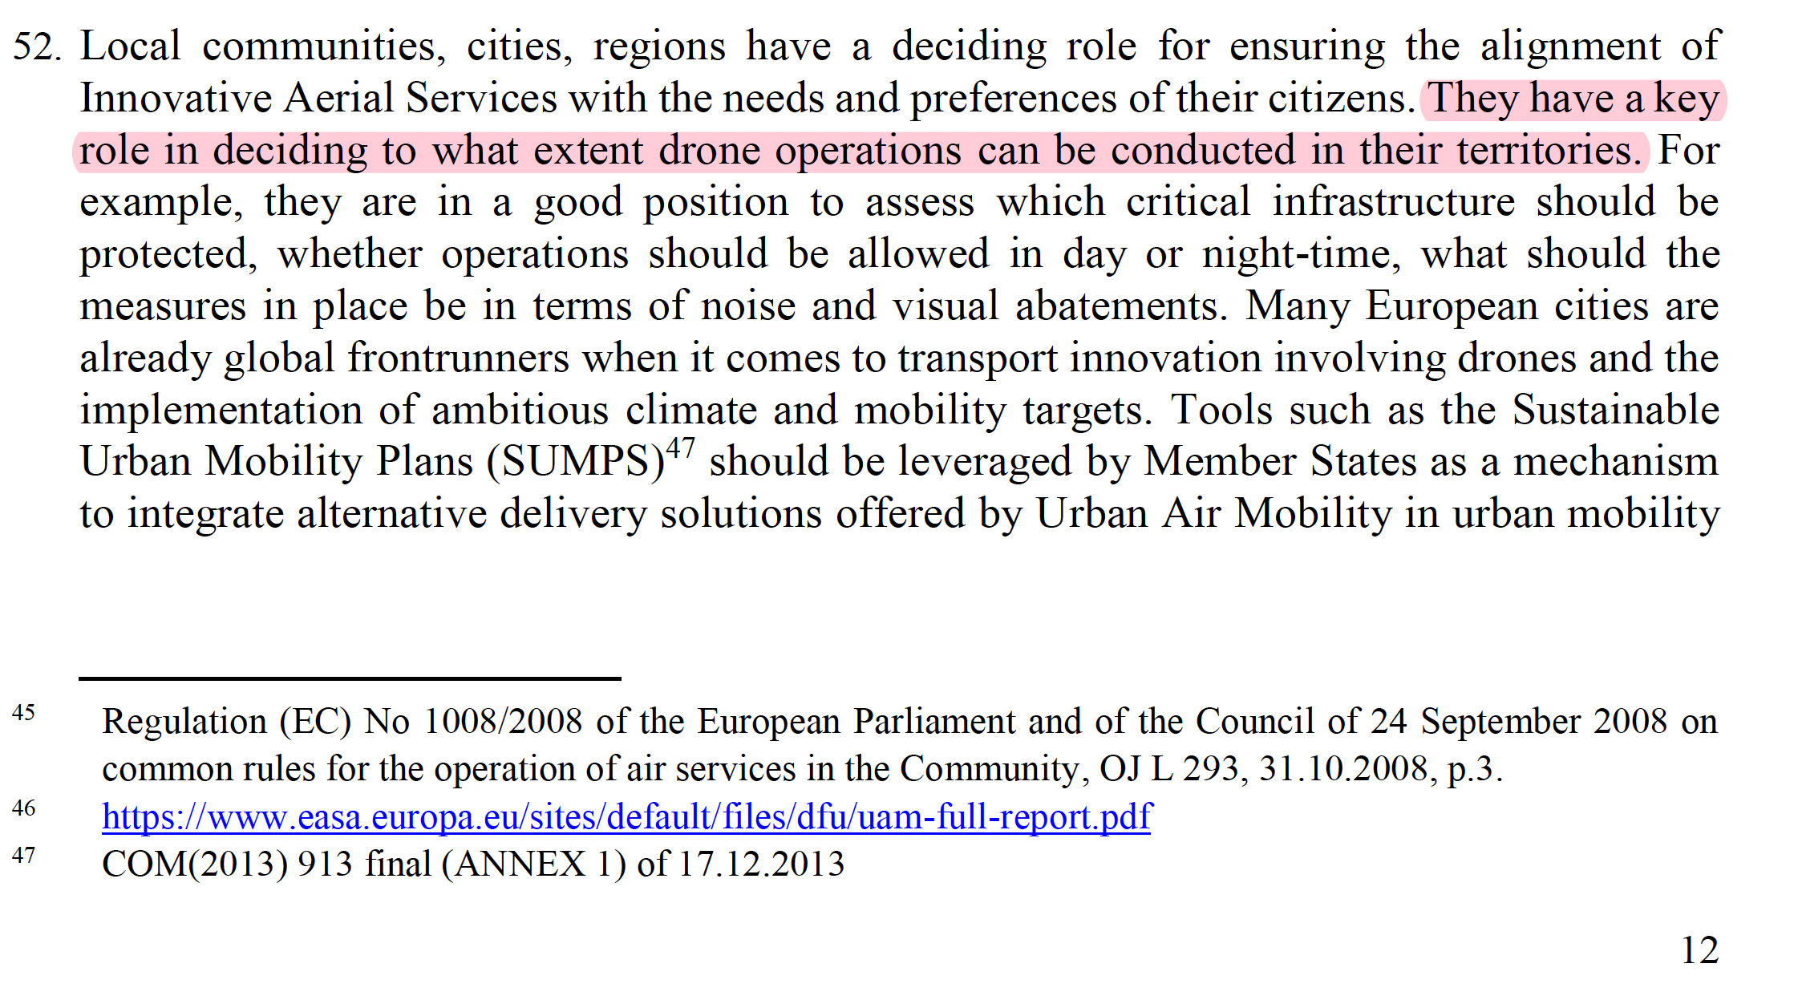
EU’s Drone Strategy 2.0
Local communities, cities, regions have a deciding role for ensuring the alignment of Innovative Aerial Services with the needs and preferences of their citizens. They have a key role in deciding to what extent drone operations can be conducted in their territories. For example, they are in a good position to assess which critical infrastructure should be protected, whether operations should be allowed in day or night-time, what should the measures in place be in terms of noise and visual abatements
Extract from the EU Drone Strategy 2.0 (Nov. 2022)
https://ec.europa.eu/commission/presscorner/detail/en/ip_22_7076
11
UIC2 • Role of local authorities in U-space: what does it mean in practice? EU Parliament, Urban Intergroup, 23 Jan 2024, Brussels
Notes:
..w praktyce to w każdej dziedzinie można wspomóc się technologią BSP…

Slide 12
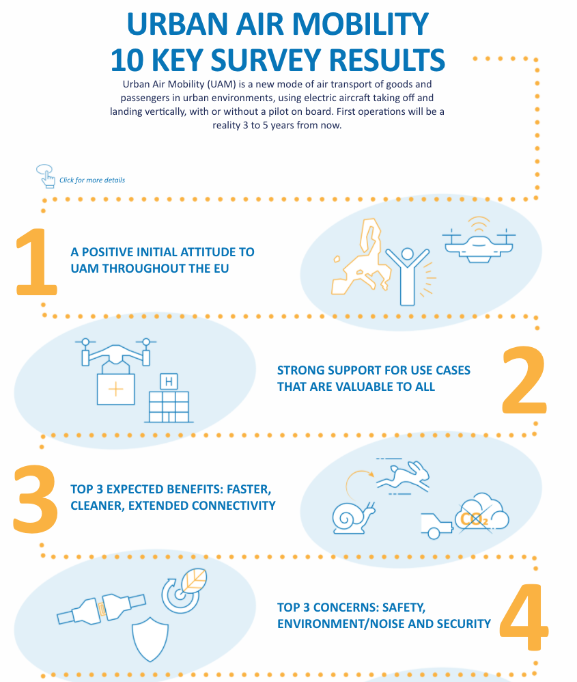
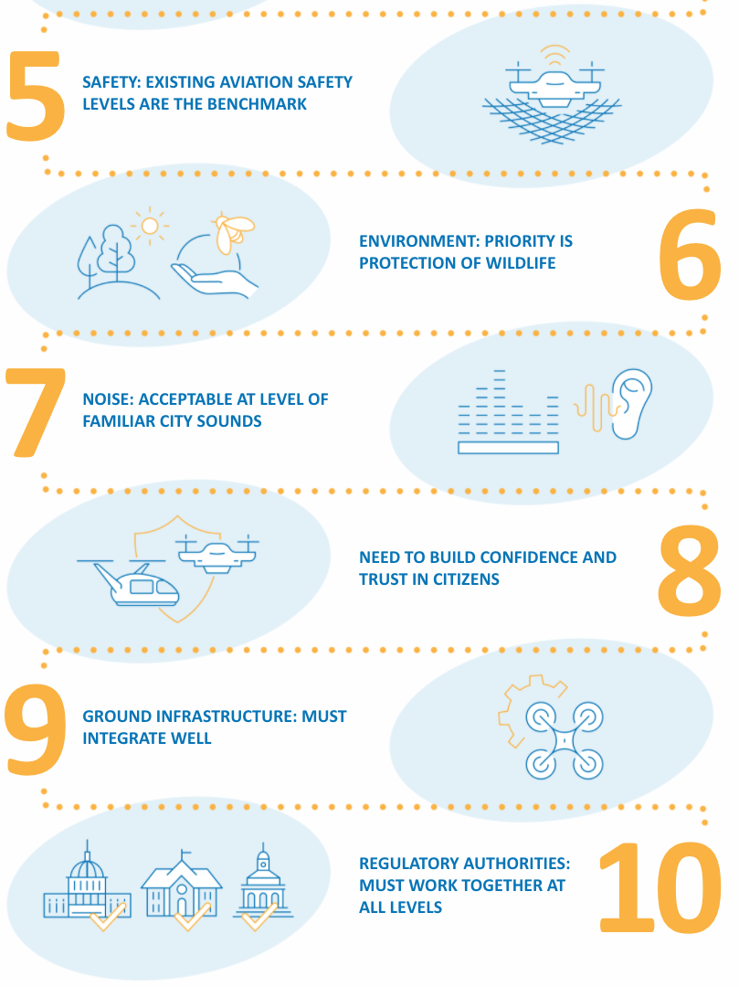
EASA UAM Social Acceptance Study:
Key findings (EU)
UAM use cases depend heavily on social acceptance topics.
Technical topics, and technological advancements although they are central to UAM progress (e.g. noise), are not the only challenges!
Cities & Regions need to take action to collectively deal with these universal themes.
Source: EASA, 2021
12
UIC2 • Role of local authorities in U-space: what does it mean in practice? EU Parliament, Urban Intergroup, 23 Jan 2024, Brussels

Slide 13

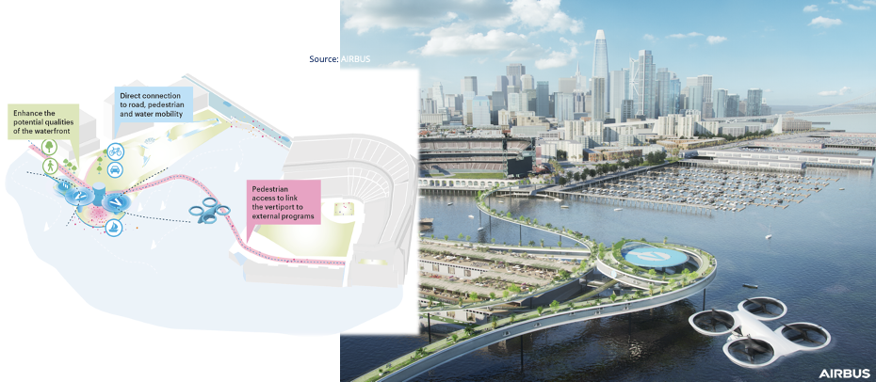
Urban Integration:
More than vertiports ...
Interfaces with a number of urban infrastructure (physical and digital) assets
Integration with surface mobility systems and wider urban planning.
UAM will be subject to policies for passenger-centric mobility services (e.g. MaaS) and sustainable urban mobility (e.g EU‘s SUMP)
Source: Airbus (2021)
13
UIC2 • Role of local authorities in U-space: what does it mean in practice? EU Parliament, Urban Intergroup, 23 Jan 2024, Brussels

Slide 14
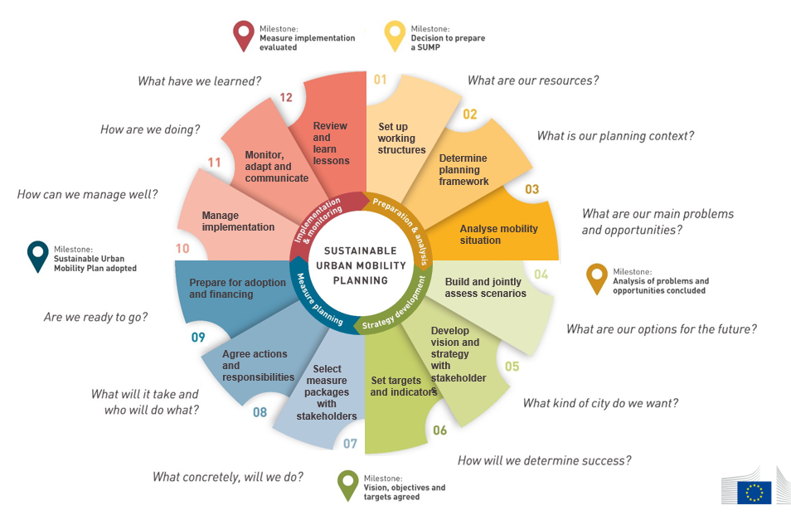
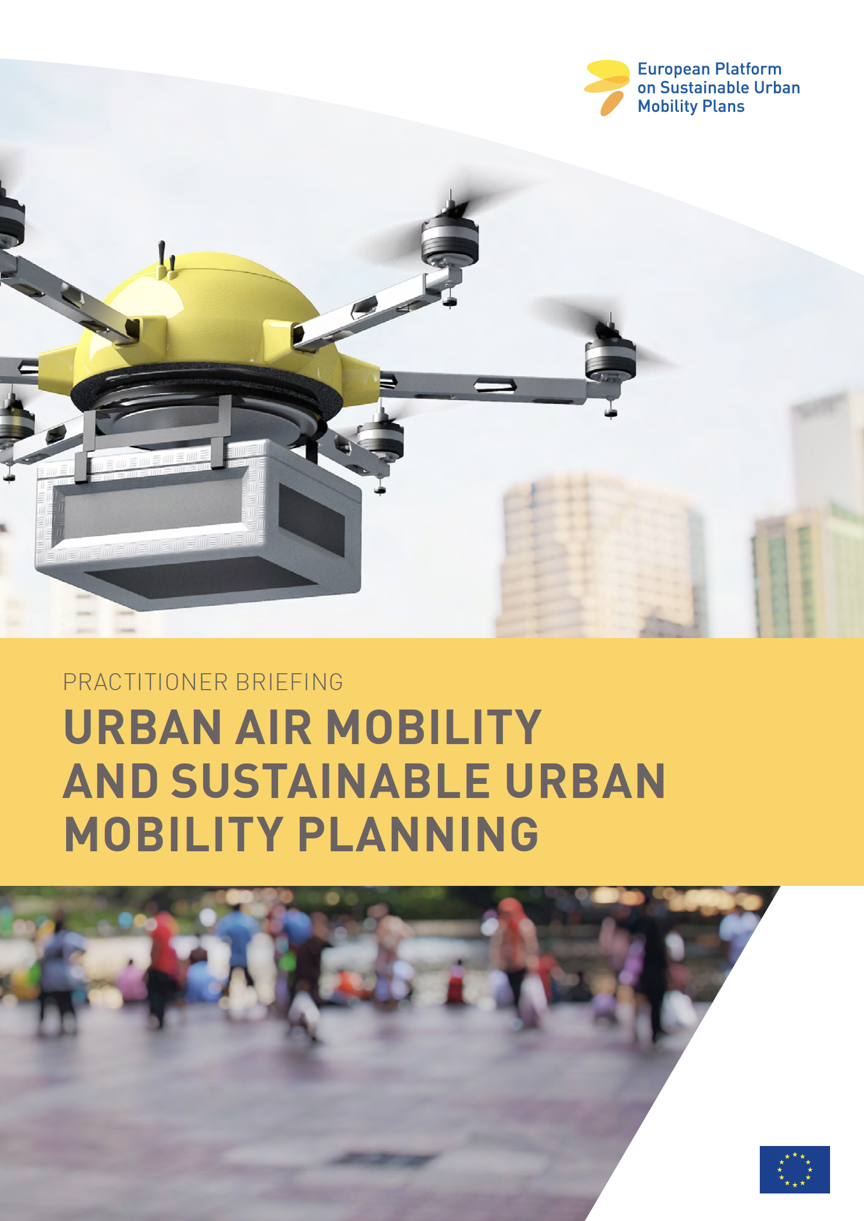
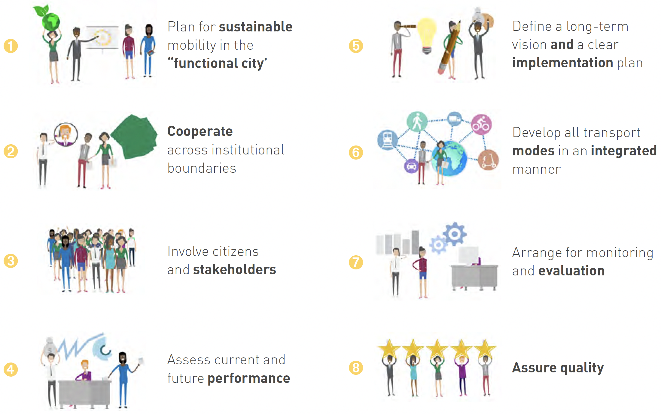
Mobility Planning:
Beyond sectoral & discipline boundaries
The SUMP-UAM Practitioner Briefing
https://www.eltis.org/in-brief/news/new-sump-practitioner-briefing-urban-air-mobility
UIC2 citiies and regions, experience, lessons learnt and reflection
14
UIC2 • Role of local authorities in U-space: what does it mean in practice? EU Parliament, Urban Intergroup, 23 Jan 2024, Brussels

Slide 15
Driving a sustainable & responsible transition
Towards a sustainable & responsible transition to UAM
A three-fold approach is required
UIC2 serves as a city-centric platform to:
Ensure a holistic approach to urban mobility/ traffic
Proactively engage with local authorities & citizens
Co-create with public and private actors (incl. citizens)
integrated sustainable urban mobility solutions
demonstrable benefits to citizens
socially & environmentally acceptable solutions
ESTABLISH
public & private support
Reminder of Prerequisites
SEEK
ground & air synergies
Task Force:
Funding & Financing
Task Force:
Regulation
Task Force:
Urban Mobility Planning
EIB Study & Report on UAM
OECD-ITF Report on Drones
EU H2020 UAM Funding
(3 RIA/MG3.6 + 1 CSA/LG-1.12 & Advisory Boards)
Cities & Regions
in the driving
seat
DG-MOVE / SUMP-UAM Practioner’s Guide (Dec 2021)
Member States UAM Funding for Cities & Regions
(Ingolstadt-DE, Toulouse-FR, Hamburg-DE, Aachen-DE, Norrth Hesse-DE, etc.)
Task Force:
Regulation
Task Force:
Regulation
EASA IAM Hub (2022)
ICAO AAM SG (May 2023)
ESA – Space for UAM
U-SPACE Regulatory Framework
(UIC2 Manifesto & EASA AMC/GM)
Task Force:
Public Co-Creation & Social Embracement
Close collaboration with:
POLIS Network / Ertico-ITS Europe / UITP / EIT UM / ARC
DG-HOME,
EU Handbook for securing cities from non-cooperative UAS
CO-CREATE
with citizens
15
UIC2 • Role of local authorities in U-space: what does it mean in practice? EU Parliament, Urban Intergroup, 23 Jan 2024, Brussels

Slide 16

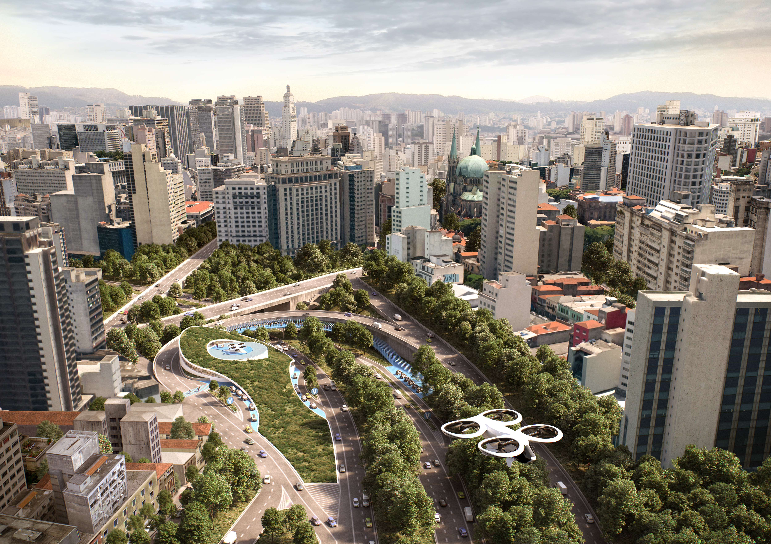
It is all about a Socio-Political Business Ecosystem
i.e. it’s not about what technology can do for us but what we want technology to do for us!
Thank you!
contact: uam@civitas.eu
Source: AIRBUS
16
UIC2 • Role of local authorities in U-space: what does it mean in practice? EU Parliament, Urban Intergroup, 23 Jan 2024, Brussels

